Slide 1

DATA STRUCTURES AND ALGORITHMS - 2
Project Title: Power Grid AI
Section: 12
Batch: 15
2520030211 Bhaarathi
2520090232 Sahithya
Under the guidance of
Dr . Chaitanya Kumar
Term -3 semester 2025-2026

Slide 2
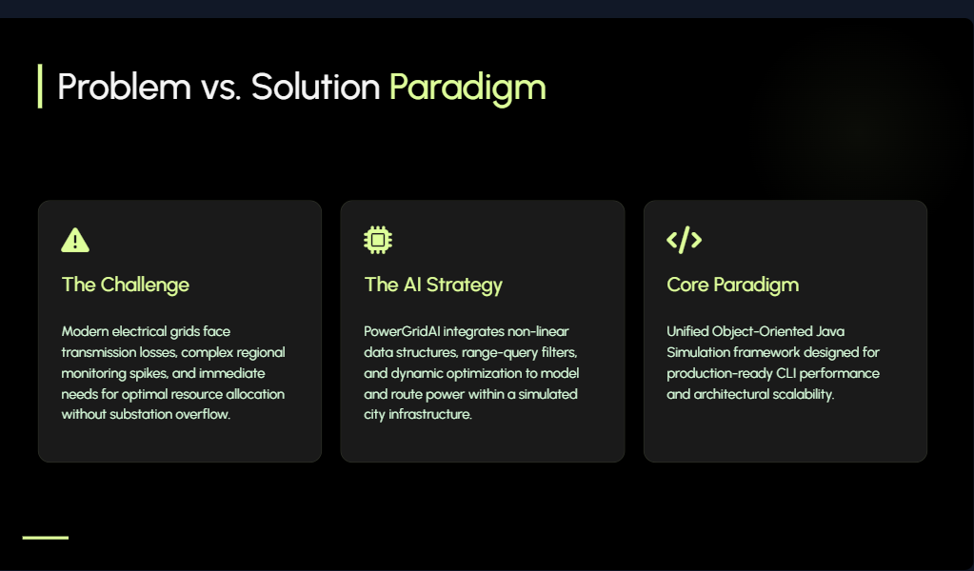

Slide 3
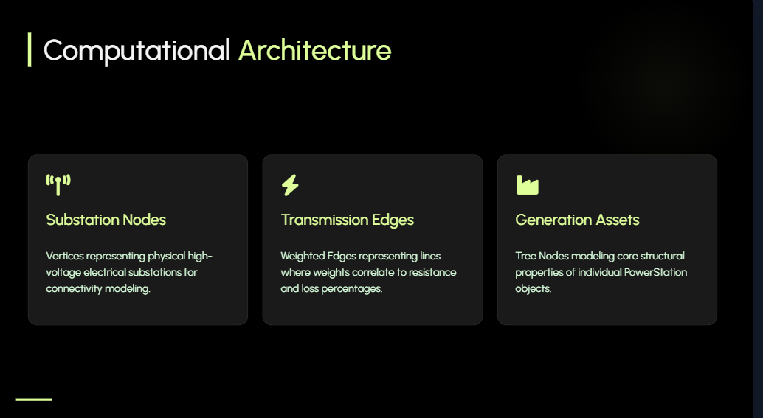

Slide 4
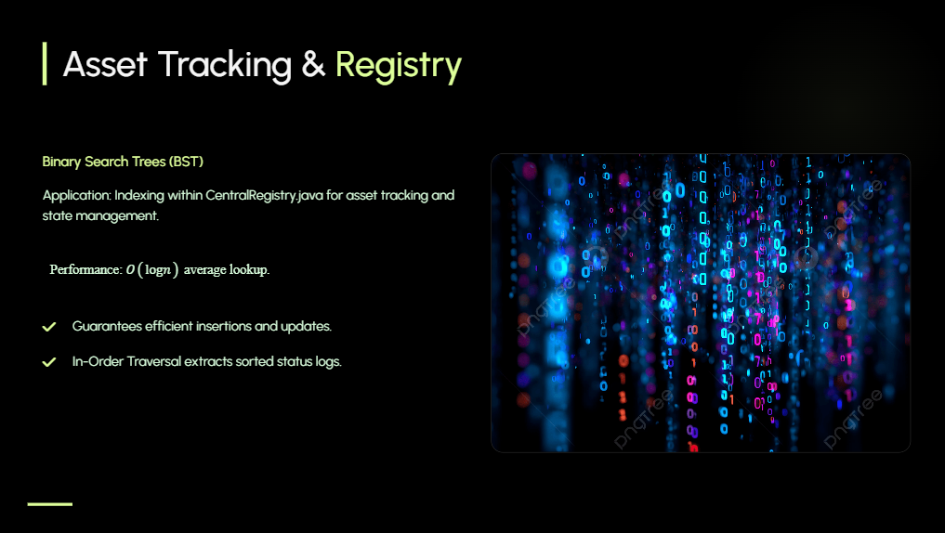

Slide 5
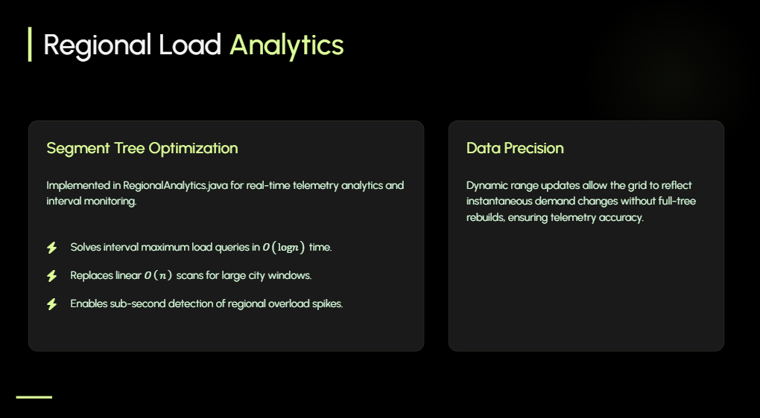

Slide 6
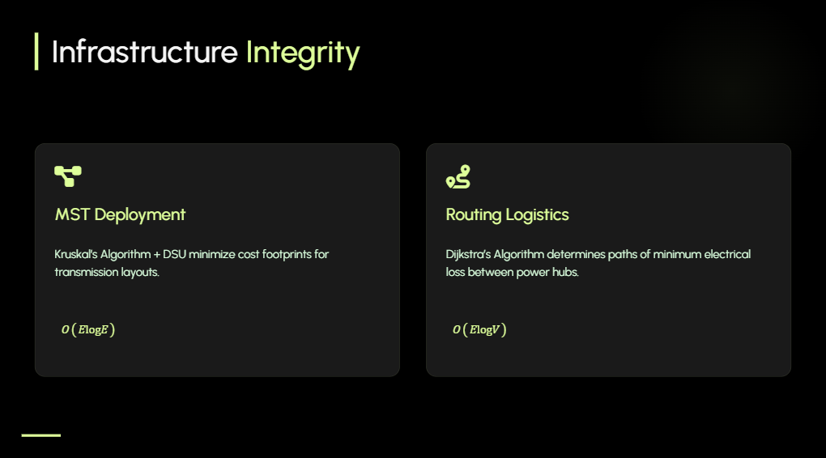

Slide 7
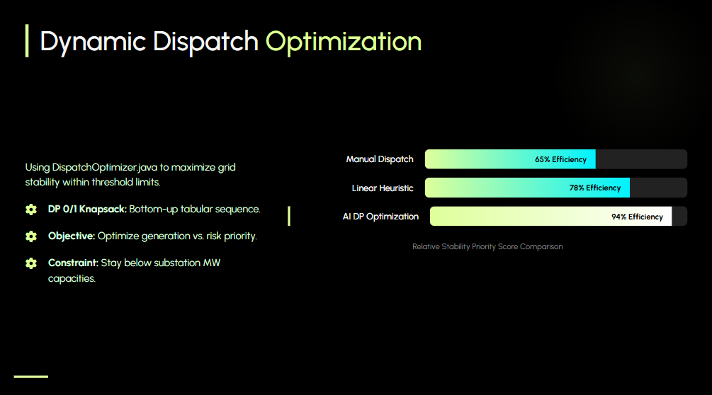

Slide 8
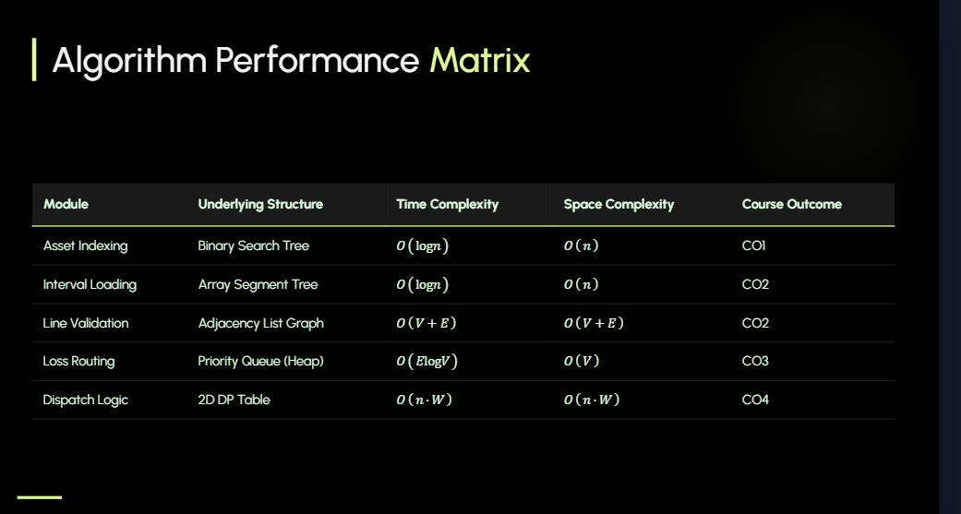

Slide 9
